Slide 1
Cat Gallery
Team
https://github.com/xpucu/team-moon

Slide 2

Software Requirements Specification
Team

Slide 3
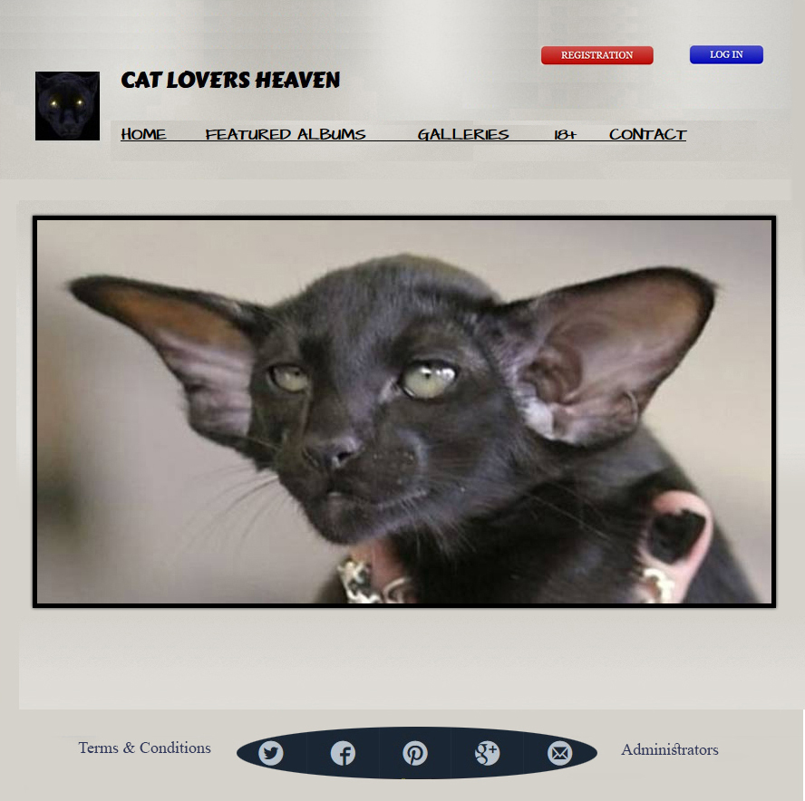
Team

Slide 4
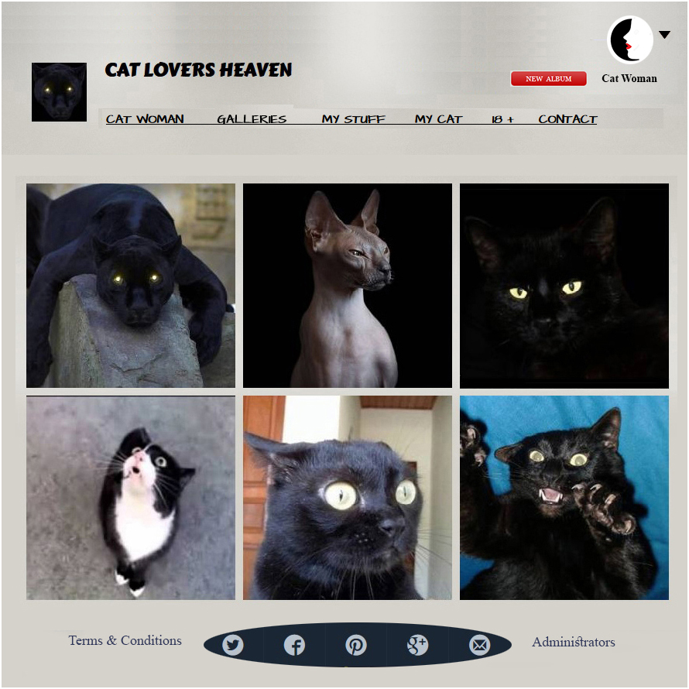
Team

Slide 5
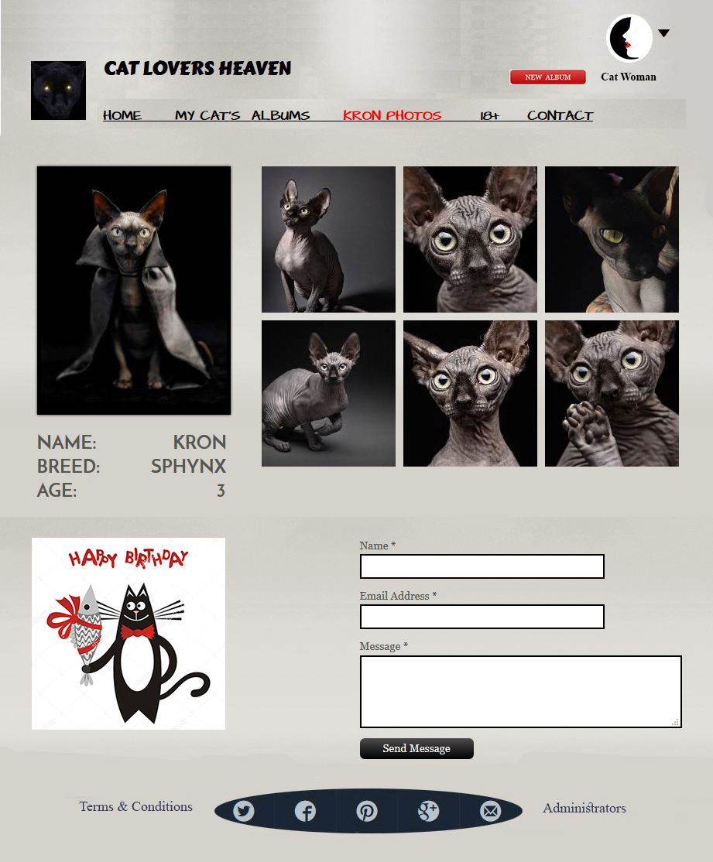
Team

Slide 6

Test Scenarios and Test Cases
Team

Slide 7
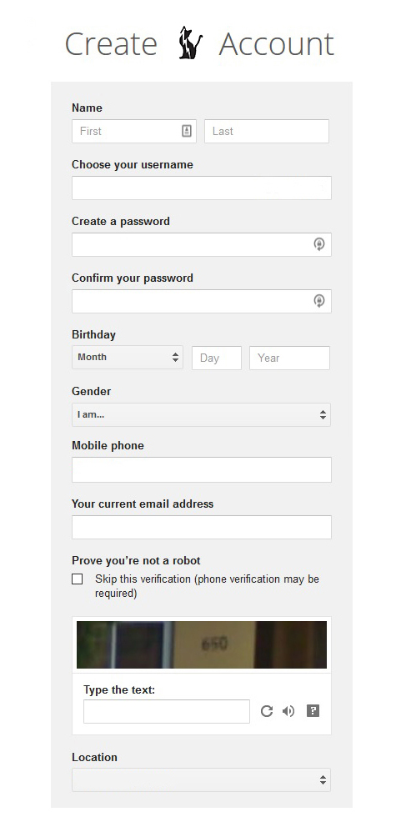
Team

Slide 8
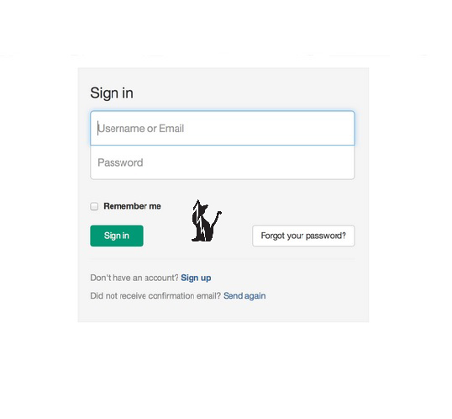
Team

Slide 9
Members
Team
Gabriela Banova
Daniel Georgiev
Hristo Bahnev
Debora Zhelyazkova
Hristina Stoykova
Boris Kirilov
Anton Hadzhiev

